Slide 1

ML-based Cyberattack Detection in Industrial Control Systems (ICS) Sergio Elizalde, Samia Choueiri
College of Engineering and Computing, University of South Carolina
ITEC 590 - Topic: Applied AI and Machine Learning for Cybersecurity

Slide 2
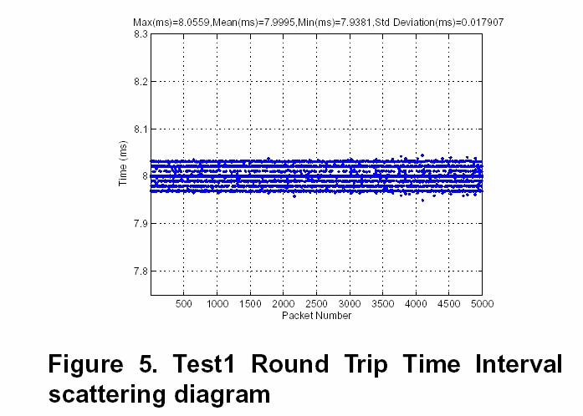
Motivation
Industrial Control Systems (ICSs) require real-time, low-latency communications
Cyberattacks and physical faults overlap, making detection more difficult
Traditional IDS is CPU-intensive and slow, unsuitable for ICS
Less than 100 µs jitter
(a) Round-trip time interval¹
[1] J. Moyne, Performance Metrics for Industrial Ethernet, NSF Engineering Research Center for Reconfigurable Manufacturing Systems, College of Engineering, University of Michigan, 2006.
Notes:
Figure shows characterization of Industrial ethernet (profinet) for a topology of 1 to 5 switches

Slide 3
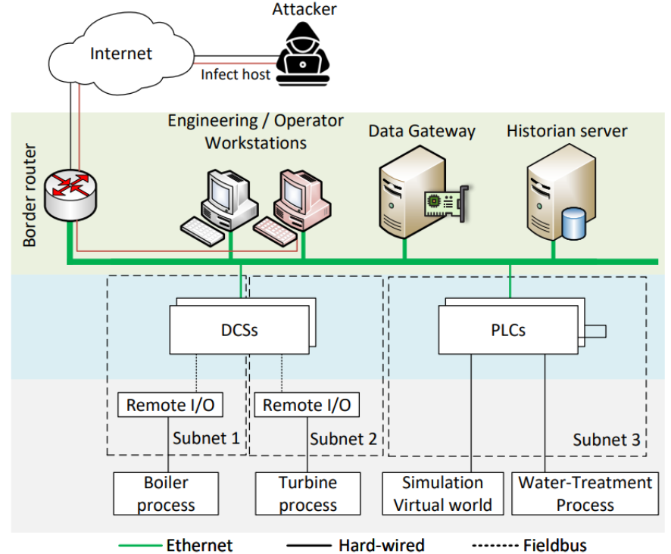
Physical faults often present a shift or a drift in the signal
(a) Tank level sensor fault (for PLC2 in the dataset)

Slide 4
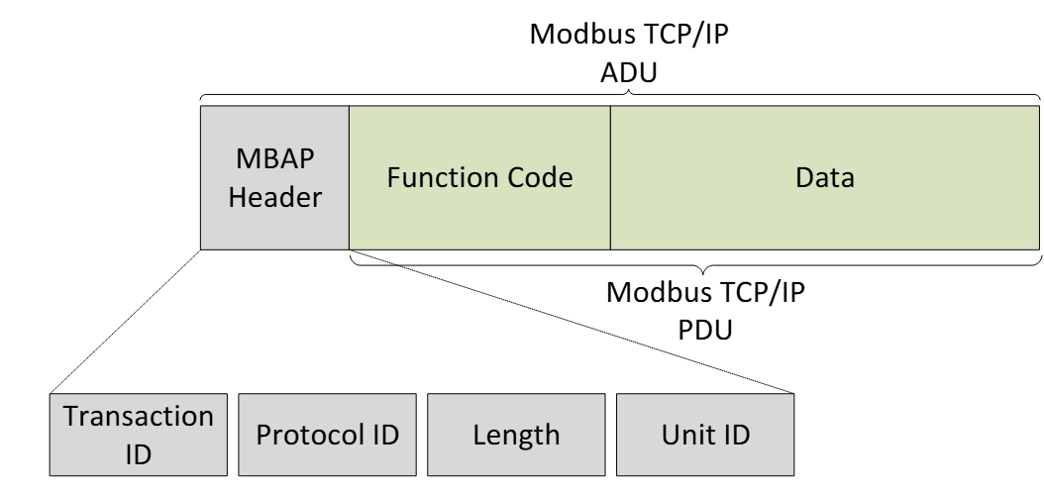
Modbus TCP/IP
Application-layer client/server communication protocol
Enables data exchange between control devices (i.e., PLCs, HMIs, etc.)
Runs over standard Ethernet networks
(a) Modbus packet
Notes:
The Modbus Application Protocol header (MBAP) identifies the transaction and device
Function code defines control operation (e.g., read register, write register)
The data field carries sensor values (e.g.,1, 2 bytes of sensor raw value)
ADU: application data unit
PDU: protocol data unit

Slide 5
Datasets
ICS dataset [zenodo]¹:
Emulated industrial process with PLCs and HMIs
Synchronized sensor, log, and network data
Normal, fault, and cyber-attack scenarios
DataSense [CIC]²:
Real IIoT testbed with heterogeneous industrial devices
Synchronized sensor telemetry and network traffic streams
50 realistic attacks across seven threat categories
Sudyana, D. (2025). ICS Dataset [Data set]. Zenodo. https://doi.org/10.5281/zenodo.17165850
Firouzi, A., Dadkhah, S., Maret, S. A., & Ghorbani, A. A. (2025). DataSense: A Real-Time Sensor-Based Benchmark Dataset for Attack Analysis in IIoT with Multi-Objective Feature Selection. Electronics, 14(20), 4095.

Slide 6
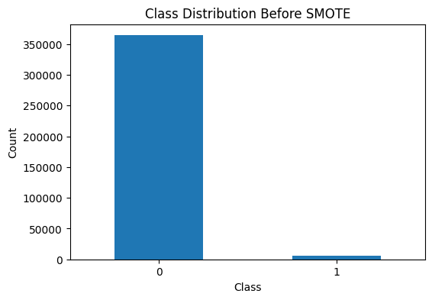
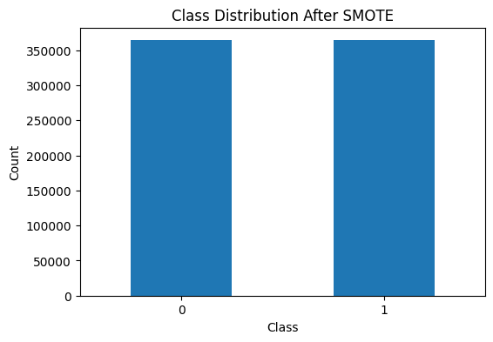
Datasets Balancing

Slide 7
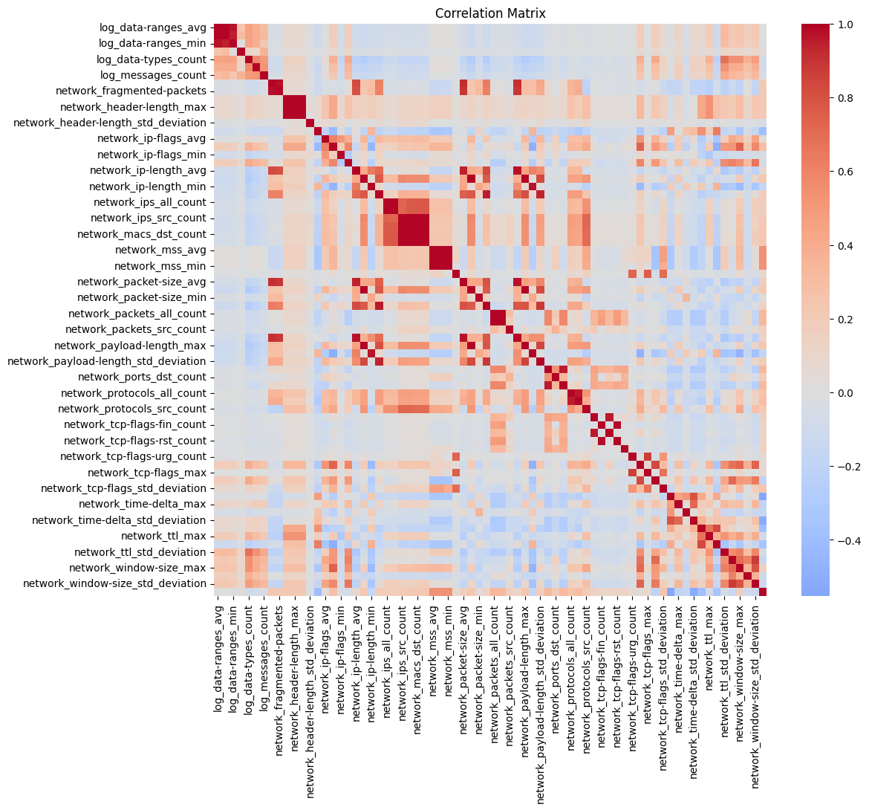
Feature Correlation
Notes:
The Modbus Application Protocol header (MBAP) identifies the transaction and device
Function code defines control operation (e.g., read register, write register)
The data field carries sensor values (e.g.,1, 2 bytes of sensor raw value)
ADU: application data unit
PDU: protocol data unit

Slide 8
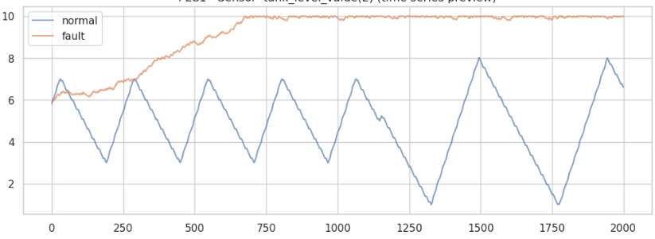
Sequential signal processing
Physical faults often present a shift or a drift in the signal
Exponentially Weighted Moving Average (EWMA) captures gradual drift
Cumulative Sum (CUSUM) captures change in the mean (i.e., detect persistent shifts)
Both are cheap to compute in the SmartNIC
(a) Tank level sensor fault (for PLC2 in the dataset)

Slide 9
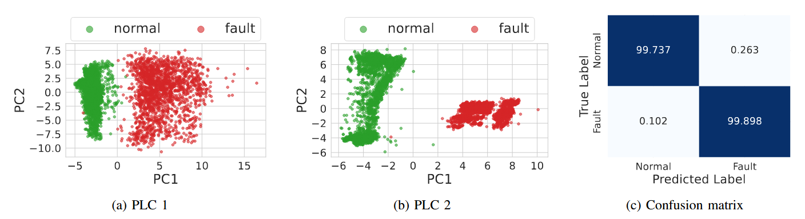
Results: Sensor fault detection
For each PLC, we conducted Principal Component Analysis (PCA)
The number of components is 2
An MLP model is trained to show classification feasibility
Notes:
Each PLC manages different plants, having different sensors
With PCA, we can see clearly separated components that can be classified
With an MLP, we get almost 100%
Conducting PCA on the go is expensive
Instead, we track transactions, not faulty PLCs with many sensors, being more granular

Slide 10
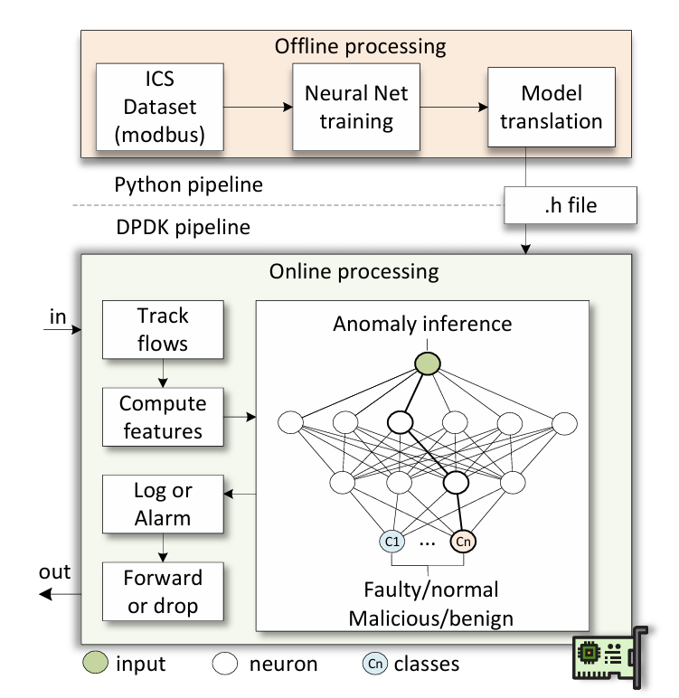
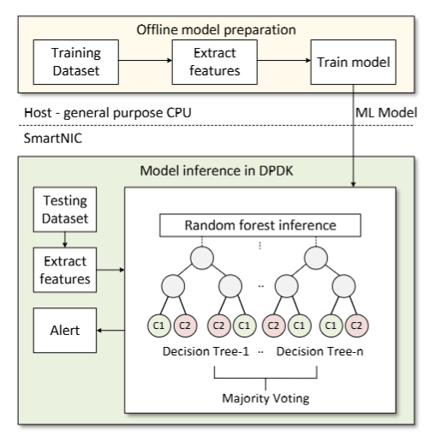

Slide 11
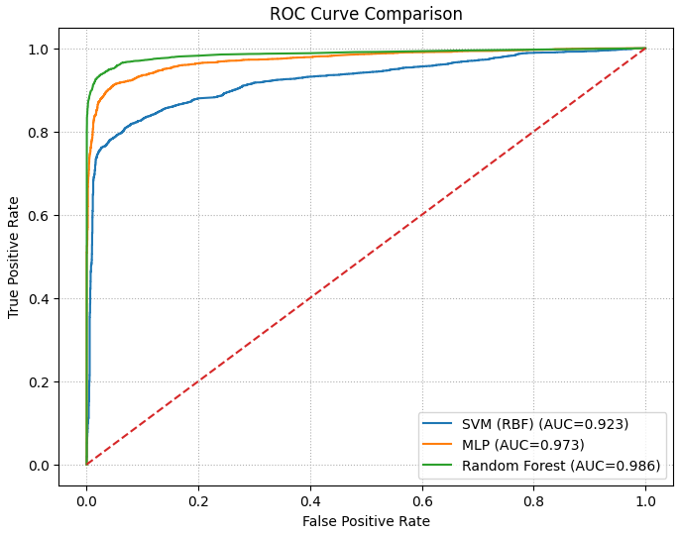
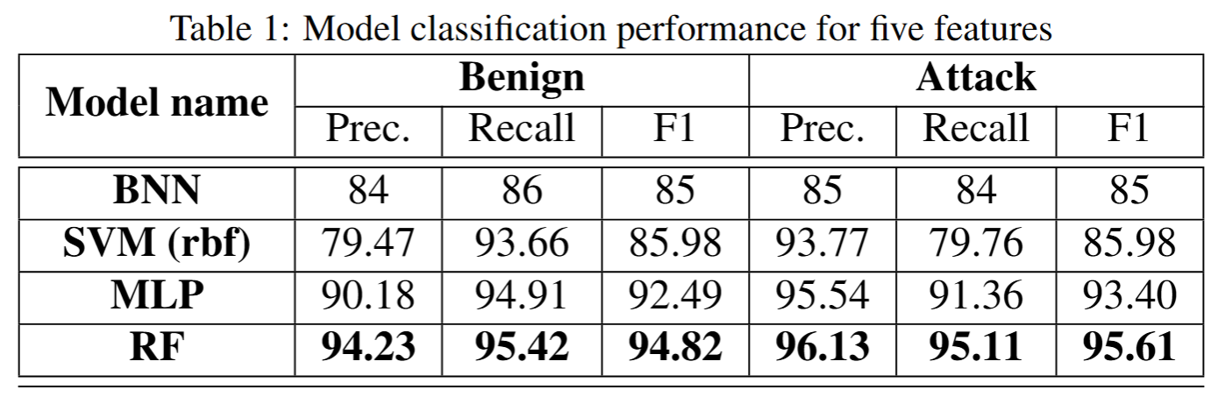
Results: Models performance
Tested 4 models
RF best results
Notes:
Each PLC manages different plants, having different sensors
With PCA, we can see clearly separated components that can be classified
With an MLP, we get almost 100%
Conducting PCA on the go is expensive
Instead, we track transactions, not faulty PLCs with many sensors, being more granular

Slide 12
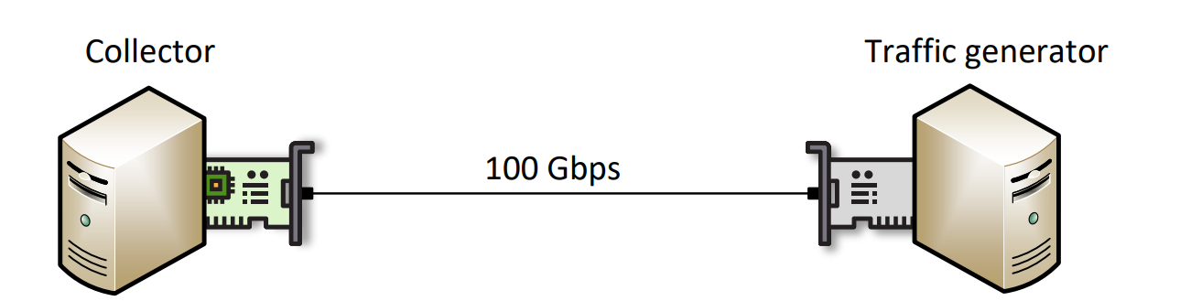
Experiment Topology
The topology consists of two nodes:
Collector node, equipped with an NVIDIA BlueField (BF)
Traffic generator node, equipped with an NVIDIA ConnectX-6

